Slide 1
Eric Meeks (UCSF) Leslie Yuan (UCSF) OpenSocial Gadget Update from UCSF June 17, 2011 – Harvard Profiles User Group Meeting

Slide 2
What is OpenSocial?
OpenSocial is a set of common application programming interfaces (APIs) for web-based social network applications, developed by Google along with MySpace and a number of other social networks.

Slide 3
UCSF Goals
Extend UCSF Profiles, building new features without touching core Profiles code
Create an OpenSocial standards-based library of shareable gadgets
Foster a community across institutions for building and sharing knowledge and gadgets
Harness existing communities and gadgets

Slide 4
Where are we today?
Make Profiles an OpenSocial Container
Build a library of useful gadgets
Faculty Mentoring
Document Sharing via SlideShare.net
Live hyperlinks within a profile
Profile List Tool
Google full text search of profiles
Working on more gadgets (activity streams and more… )

Slide 5
Quick Demo (see http://profiles.ucsf.edu) For Slideshare gadget, search for investigator Ida Sim For Mentoring gadget, search for investigator Jeanette Brown

Slide 6
Technical Notes
First requirement: extend the Profiles to be an OpenSocial enabled platform
Apache Shindig + the Profiles API
Then develop gadgets – which are:
Lightweight & easily developed
Usually under 500 lines of code
E.g., Mentor Gadget Source Code = XML, HTML & JavaScript

Slide 7
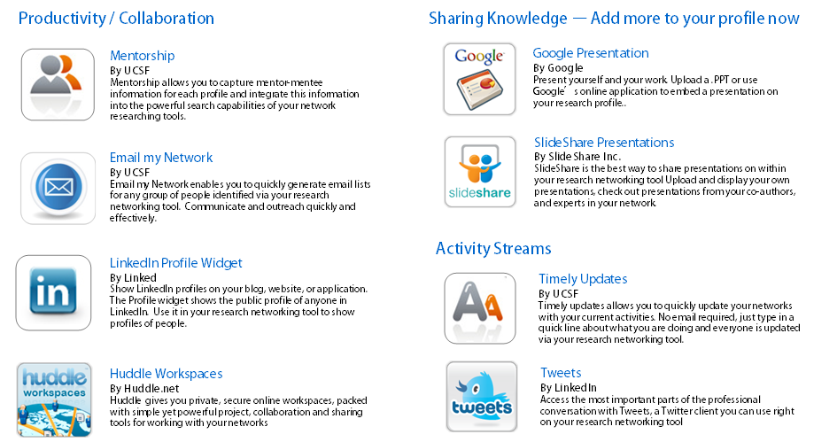
Where to now? An Open Community for Application Sharing
UCSF
Profiles
Harvard
Profiles
LinkedIn
iGoogle
Stanford
VIVO
Application Library

Slide 8
Thanks!
The Profiles Team
The Shindig Team
Andy Smith (IBM), Mark Weitzel (IBM) and the OpenSocial Foundation
Contact:
Eric.meeks@ucsf.edu
Leslie.yuan@ucsf.edu

